Slide 1
Where should Tom Open his Coffee shop?

Slide 2
Background
Tom wants to open a coffee shop in the neighborhood of Toronto
He wants to check the existing coffee shop in Toronto
He wants to open it in the neighborhood with averaged number of coffee shop to avoid excessive competition or lack of customers
As a beginner in the business, Tom prefers other coffee shops in his neighborhood have an average rating of at most 7.5

Slide 3
Data needed
Location data of neighborhood in Toronto
Coffee shop information including their exact locations and ratings
All data need to be cleansed before utilization

Slide 4
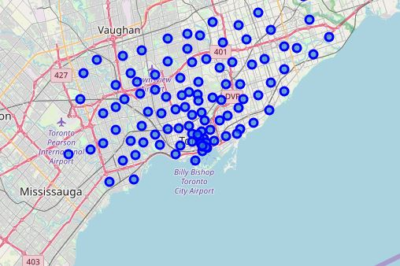
Neighborhood in Toronto

Slide 5
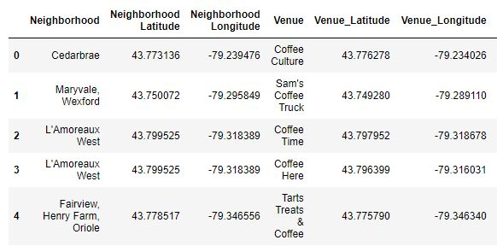
Coffee shop information
Selected coffee shops’ name and location data

Slide 6
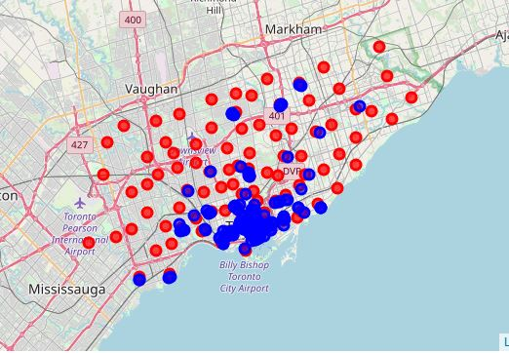
View all coffee shops on the map
All coffee shops in Toronto are highlighted in blue
All neighborhood locations are highlighted in red

Slide 7
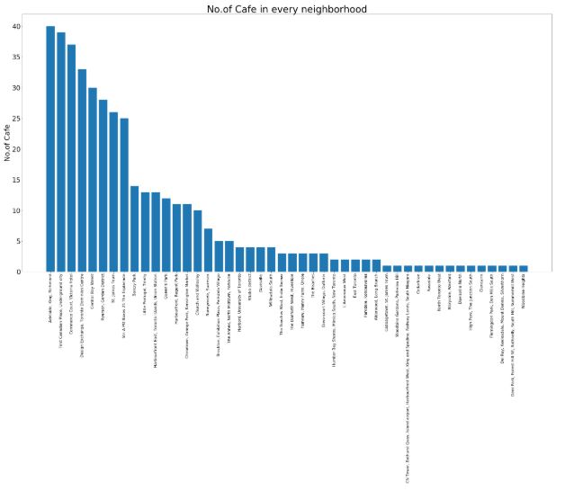
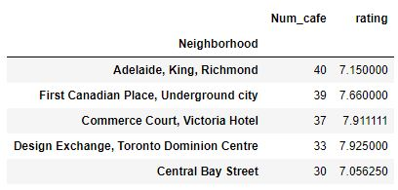
Number of coffee shop and their average rating by neighborhood

Slide 8
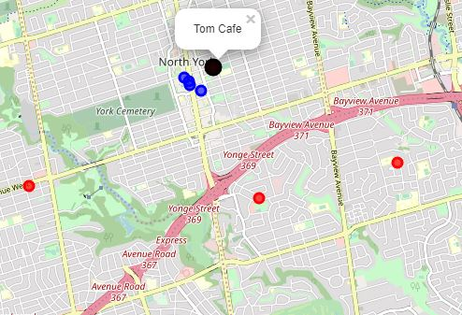
Final location of Tom’s coffee shop
Final location: Willowdale South

